Slide 1

SQL Data Cleaning Project: Global Layoffs

Slide 2
The Data Cleaning Blueprint
01
02
03
Establish a Staging Area
Identify & Remove Duplicates
Standardize & Correct Data
Create a working copy of your raw data to ensure data integrity and traceability.
Pinpoint and eliminate redundant entries that can skew analysis.
Unify inconsistent formats and rectify errors for uniform data representation.
04
05
Address Null Values
Refine Dataset Structure
Strategically handle missing data points, either by imputation or removal.
Remove unnecessary columns or rows to streamline the dataset for analysis.

Slide 3

Step 1: Staging Your Data
Why Stage Data?
Preserve raw data source.
Isolate cleaning operations.
Facilitate iterative cleaning.
GML Code
CREATE TABLE world_layoffs.layoffs_staging LIKE world_layoffs.layoffs; INSERT layoffs_staging SELECT * FROM world_layoffs.layoffs;
This staging table acts as a safe environment where you can perform all your cleaning operations without altering the original raw data.

Slide 4

Step 2: Identifying & Removing Duplicates
Duplicate records can significantly impact your analysis, leading to inflated counts or incorrect aggregations.
Detecting Duplicates
SELECT *, ROW_NUMBER() OVER ( PARTITION BY company, location, industry, total_laid_off, percentage_laid_off, date, stage, country, funds_raised_millions ) AS row_num FROM world_layoffs.layoffs_staging;
Removing Duplicates
A robust approach involves creating a temporary table to store the processed data, ensuring that only unique records are retained. This method is often preferred over direct deletion for better control and verification.
CREATE TABLE world_layoffs.layoffs_staging2 ( ... -- all columns from original table row_num INT ); INSERT INTO world_layoffs.layoffs_staging2 ( ... -- all columns ) SELECT ..., ROW_NUMBER() OVER (...) AS row_num FROM world_layoffs.layoffs_staging; DELETE FROM world_layoffs.layoffs_staging2 WHERE row_num >= 2;

Slide 5

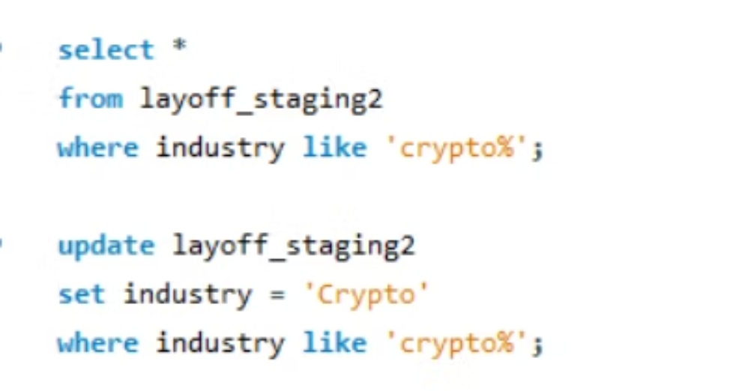
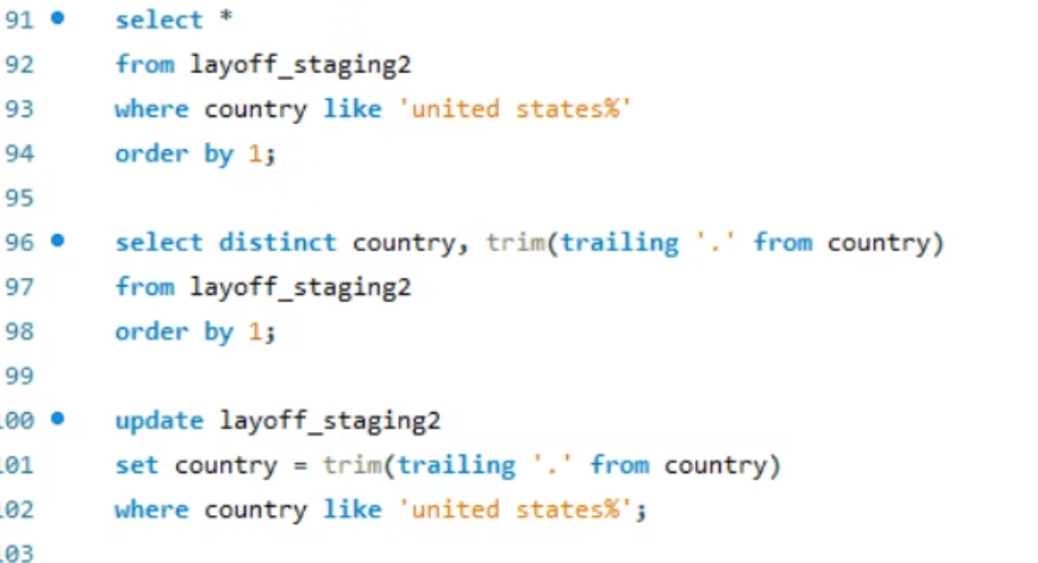
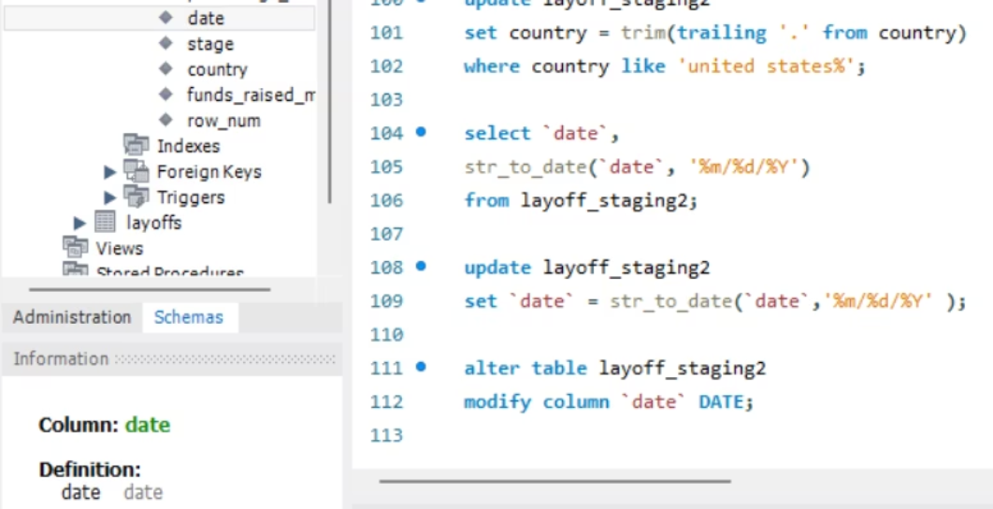
Step 3: Standardizing Data Formats
Standardizing data ensures that all entries for a given attribute are uniform. This includes correcting typos, unifying categorical values, and formatting dates correctly.
Consolidate Industries
Clean Country Names
Format Date Fields
Group similar categories like 'Crypto Currency' and 'CryptoCurrency' into a single 'Crypto' entry.
Remove trailing punctuation or extra spaces from country names.
Convert date strings into a consistent DATE format for accurate temporal analysis.

Slide 6

Handling Nulls and Empty Strings
For categorical fields, it's often beneficial to convert empty strings to NULL for easier processing and consistent handling.
Converting Blanks to Nulls
UPDATE world_layoffs.layoffs_staging2 SET industry = NULL WHERE industry = '';
For fields where a valid value exists for other records of the same entity (e.g., company), you can impute missing values by joining the table to itself.
Imputing Missing Values
UPDATE layoffs_staging2 t1 JOIN layoffs_staging2 t2 ON t1.company = t2.company SET t1.industry = t2.industry WHERE t1.industry IS NULL AND t2.industry IS NOT NULL;

Slide 7





When to Handle Nulls: Insights
Total Laid Off: NULL
Percentage Laid Off: NULL
Often indicates no layoffs for a period or company, or data was not reported.
Similar to total laid off, a missing percentage may mean zero layoffs or unknown figures.
Decision Point
Funds Raised: NULL
Not all nulls need imputation. Consider the context: if total_laid_off and percentage_laid_off are both NULL, it might indicate rows that provide no value to layoff analysis.
This could imply self-funded companies, private funding not disclosed, or simply unrecorded data.
It's crucial to evaluate each null column individually. For some, like total_laid_off, percentage_laid_off, or funds_raised_millions, nulls might be meaningful (e.g., no layoffs, no external funding) and should be left as is.

Slide 8

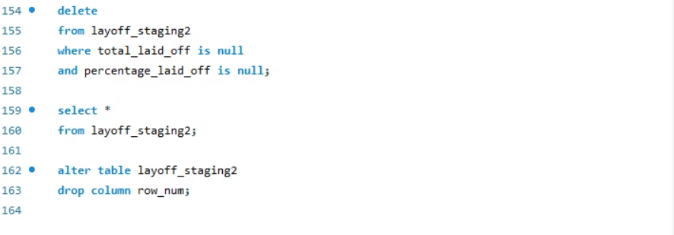
Step 4: Removing Useless Rows & Columns
The final step involves refining your dataset by removing any data that doesn't contribute to your analytical goals.
Identify & Delete

Slide 9
Thank You.
Feedback welcome.
- Palak Dave

